Slide 1

Port City International University Course Title: -Object Oriented Programming Sessional Course Code: -212 Project Name: -Hotel Management System Group: - 06
Presented To Presented By
Md. Muhtadir Rahman Name:- Sakhawat Hossain
Lecturer ID:- CSE 02107065
Department of CSE Name:- Rizbi Ahmmad
ID:- CSE 02107051
Name:- Tonmoy Barua
ID:- CSE 02107059

Slide 2
CONTENT
Problem statement Use case diagram Problem objective User interface Preliminary solution Cost analysis Project scope Application of the app System Architecture Thank You Project Stakeholder Q & A

Slide 3
Problem Statement
A “Hotel management system” manages information about rooms, reservations, customers, and customer billing .
Customer can make reservations, change, or cancel reservations through the hotel website.
When a customer makes reservations, that person needs to check if a room the customer want to reserve is available. If a room is available, the customer enters theirs information to the system and receives a confirmation number from the web site.

Slide 4
Problem Objective
The project “Hotel Management System” is aimed to develop to maintain the day-to-day state of a guest enters/Vacation of Recidents, List of Workers, payment details, etc.
The main objective of this project is to provide a solution for hotels to manage most there work using a computerized process

Slide 5
Preliminary Solution
The problem can be solved by replacing the current manual system with a computerized and automated Hotel Management application.
They system will store the data in a database and process advertisements quickly and efficiently.
It would be easily accessible and remove the hassle to get the hotel reservation for the guest or resident.

Slide 6
Project Scope
Functional Requirements
Registration Process of SRS (Software Requirements Specification)
Check Out of SRS
Report Generation of SRS
Database of SRS
Non Functional Requirements
Security
Performance
Maintainability
Reliability

Slide 7
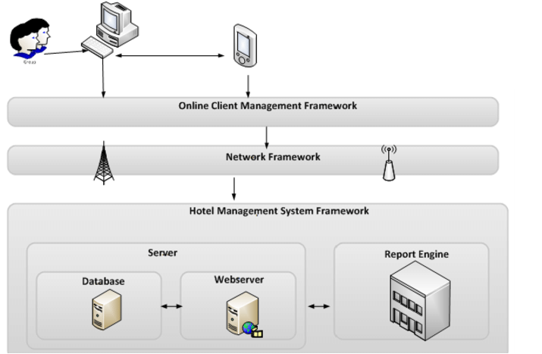
System Architecture

Slide 8
Project Stakeholder
Customers Stake:- Product/service quality and value.
Employees Stake:- Employment income and safety.
Investors Stake:- Financial returns.
Suppliers and Vendors Stake:- Revenues and safety.
Communities Stake:- Health, safety, economic development.
Governments Stake:- Taxes and GDP.

Slide 9
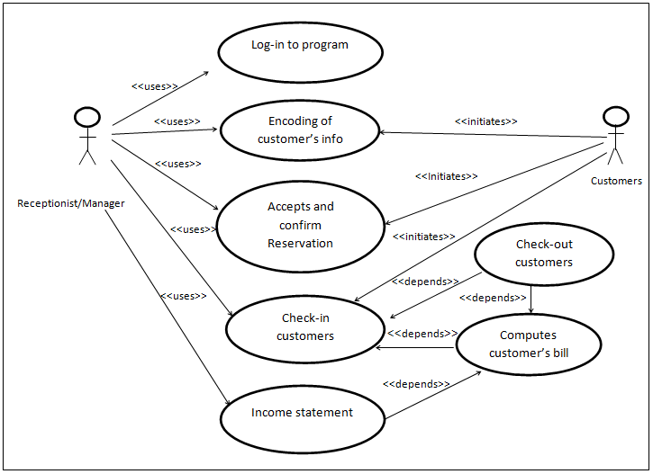
Use Case Diagram

Slide 10
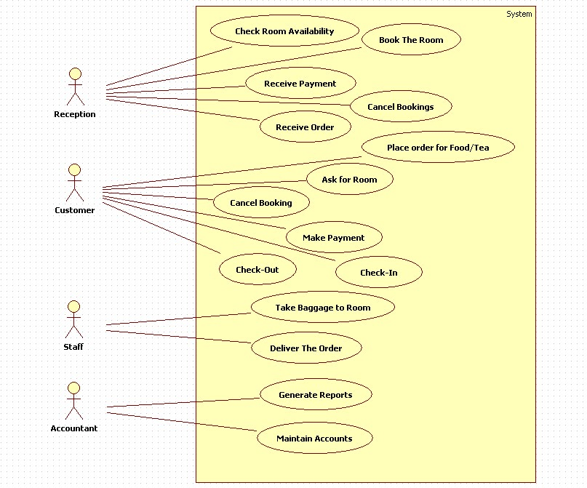
Activity Diagram

Slide 11
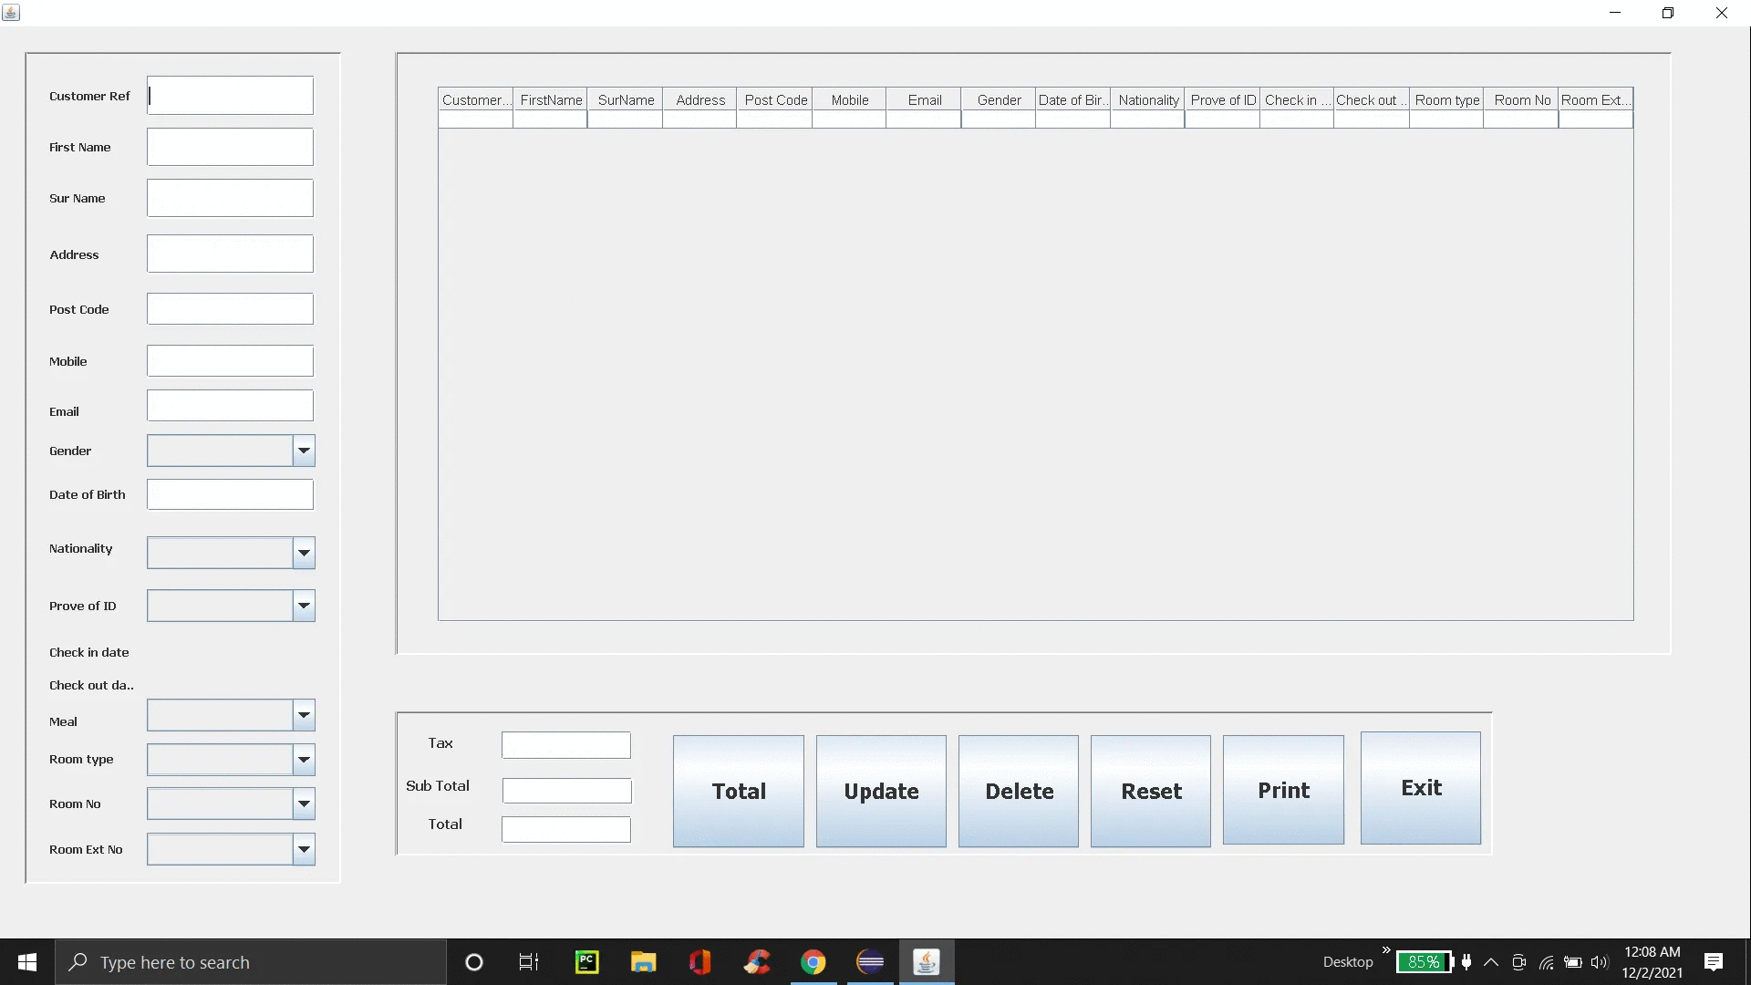
User Interface(UI)

Slide 12
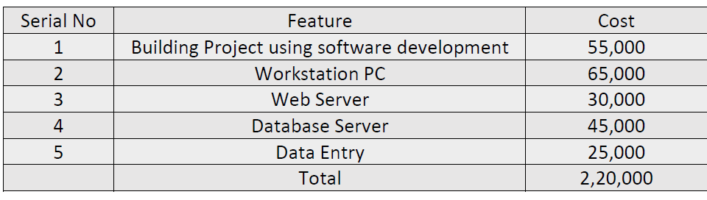
Cost Analysis

Slide 13
Application Of the App
The app is being developed targeting the Android platform. To run this app user must have an android device. With a GPS Sensor and also with internet connection must.

Slide 14
Thank You

Slide 15
(Q & A) ?

